Slide 1
Post-study workshop
Dominic De Franco

Slide 2
Outline of this workshop
Discussion: Evaluation of the diary study
Short break
Discussion : Health information situations
Short break
Discussion: patient journey
Discussion : Virtual coaches in your patient journey
Next steps
Closure

Slide 3
Discussion: Evaluation of the diary study
Could you explain how you thought the study went? What went well, what went wrong?
How easy or difficult was it to filling out the diary forms?
How could this study be improved?

Slide 4

Coffee break

Slide 5
Discussion: Health information situations
What were for you the most important health information situations you encountered?
How did these situations affect your health (positive or negative)?
Health has several aspects, such as physical health, mental health, social health, quality of life, etc. How did these health information situations affect these different aspects of your health?

Slide 6
Coffee break

Slide 7
What are virtual coaches?
We define a virtual coach as:
A virtual or robotic human-like character that demonstrates many of the same properties as humans in face-to-face conversation, including the ability to produce and respond to verbal and nonverbal communication and takes on the role of a coach.

Slide 8
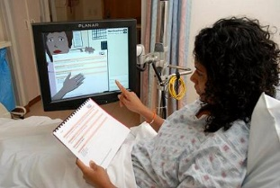
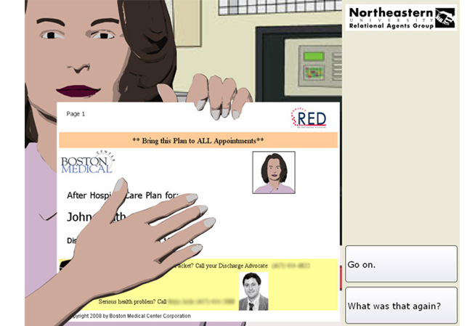
Example: The Virtual Discharge Nurse
A virtual nurse agent that conducts a bedside dialogue with patients immediately prior to hospital discharge.

Slide 9
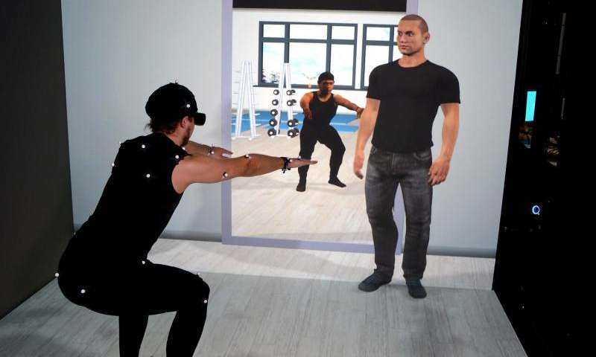
Example: a Physical Exercise Coach
Motivate users to do the exercises and provides them with clarification as to which movements the user must change in order to correctly perform the exercise.

Slide 10
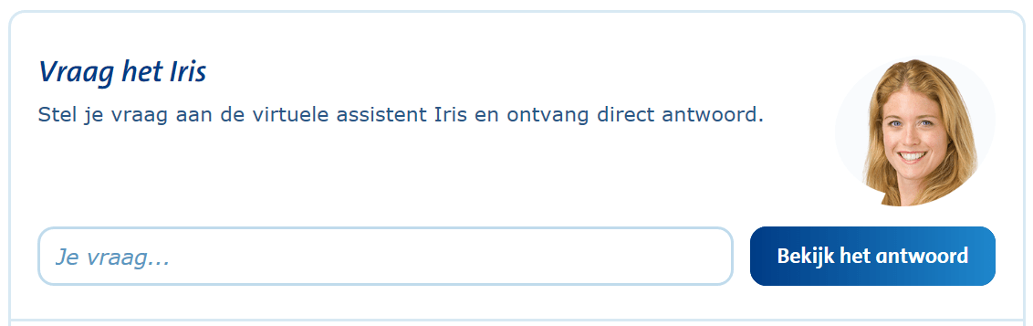
Example: Virtual Employee Iris
Ask questions on a website to Iris about insurance and other services of the ANWB (National Dutch Tourist Association).

Slide 11
Discussion: Virtual coaches
Where could or should virtual coaches play a role in healthcare? Please mark these places with an X on the section ‘1-Role of virtual coaches’.

Slide 12
Discussion: Virtual coaches
Where could or should virtual coaches play a role in healthcare? Please mark these places with an X on the section ‘1-Role of virtual coaches’.
For each X, please write down what the virtual coaches should do.

Slide 13
Discussion: Virtual coaches
Where could or should virtual coaches play a role in healthcare? Please mark these places with an X on the section ‘1-Role of virtual coaches’.
For each X, please write down what the virtual coaches should do.
For each X, please write down what type of information you would need.

Slide 14
Discussion: Virtual coaches
What type of virtual coaches do you believe we should develop for this case? (e.g. physical activity coach, spiritual coach, etc.)

Slide 15
Next steps
These were the topics in the diary forms:
Situation description
Situation characteristics
Medium (website, book, etc.)
Satisfaction
Trust
Actions
How do we use this information for the creation & design of the Council of Coaches?

Slide 16

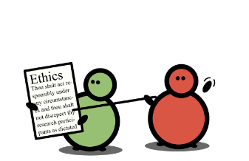


Next steps
Specify the context in which the technology is to be used
Evaluate prototype; is it usable, user-friendly, etc.
Create user criteria for the technology
Based on these criteria, designs for the prototype will be made

Slide 17
Next steps
Diary study: this study is conducted to get insights from potential user groups to know more on how eHealth technology could assist in different situations in daily life
Specify the context in which the technology is to be used
Evaluate prototype; is it usable, user-friendly, etc.
Create user criteria for the technology
Based on these criteria, designs for the prototype will be made
Notes:
This type of design process is iterative: if the evaluation at the end is not optimal, you can start a new cycle. This you do over and over again until your product satisfies user and organizational requirements.

Slide 18

Example
User study indicates that people often forget to do the exercises of their physiotherapist
Users find the reminder option is difficult to use. More information is needed how to incorporate this function in the system
Specify the context in which the technology is to be used
E-Health technology should include an option to send reminders to users to do their exercises
A prototype is made and evaluated among potential user groups
Evaluate prototype; is it usable, user-friendly, etc.
People find the reminder option very handy to use. No or minor changes
Create user criteria for the technology
Based on these criteria, designs for the prototype will be made
Design ideas are made how this reminder option should look like
Notes:
This example is NOT based on actual user data!

Slide 19
